Slide 1

Clustering Assignment
By: - Ajinkya Shakkarwar

Slide 2
Problem Statement
HELP International is an international humanitarian NGO that is committed to fighting poverty and providing the people of backward countries with basic amenities and relief during the time of disasters and natural calamities. It runs a lot of operational projects from time to time along with advocacy drives to raise awareness as well as for funding purposes.
After the recent funding programmes, they have been able to raise around $ 10 million. Now the CEO of the NGO needs to decide how to use this money strategically and effectively. The significant issues that come while making this decision are mostly related to choosing the countries that are in the direst need of aid.

Slide 3
Objective
We, HELP International humanitarian NGO, committed to fight poverty and provide the people of backward countries with basic amenities and relief during the time of disasters and natural calamities. We run a lot of operational projects from time to time, along with advocacy, drives to raise awareness as well as for funding purposes.

Slide 4
Analysis methodology.
Data collection and cleaning
Import the data Identifying the data quality issues and clean the data
Outlier analysis and removal. Removing the outlier where ever required as per understanding the problem statement
Visualizing the data: - Visualizing few original data variables to look for any pattern or correlation.
Scaling the data: - Standardizing all the continuous variables
PCA on the data:- To derive principal components. To check the variance ratios. Screeplot - plotting the cumulative variance against the number of components
PCA on the data: - To derive principal components. To check the variance ratios. Screeplot - plotting the cumulative variance against the number of components
K means clustering:- Identify the ‘k’ by silhouette analysis and sum of squared distances graph. Forming n – clusters on PCA modified data
Hierarchical Clustering:- Identify the ‘n’ via dendrogram. Forming n – clusters on PCA modified data. Visualizing the clusters with various variables
Decision Making: - Identifying the countries which requires aid by analyzing both K-means and Hierarchical Clustering results.

Slide 5
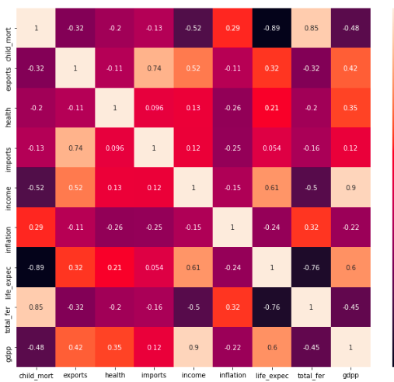
Correlation in the data:
After data cleaning , we removed outlier from gdpp column because the country with high gdpp would not require any aid as there are already doing good. • We did standardized scaling to standardize all parameters on cleaned, outlier removed data. • Looking at the heatmap, we see that few variables like (total fertility, child mortality) , (income , gdpp) and (imports and exports) have high correlation.

Slide 6
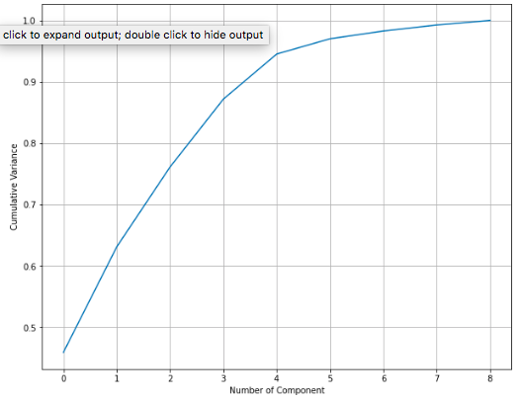
Principal Component Analysis
Looking at the screeplot , we see that 95% of variance in the data is explained by 5 components.

Slide 7
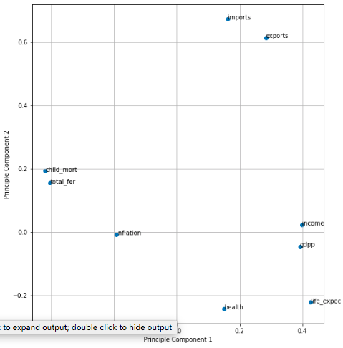
Principal Component Analysis
We see that features like gdpp, life expectancy and income are along the direction of PC1 and other features like total fertility and child mortality are along PC2 direction.

Slide 8
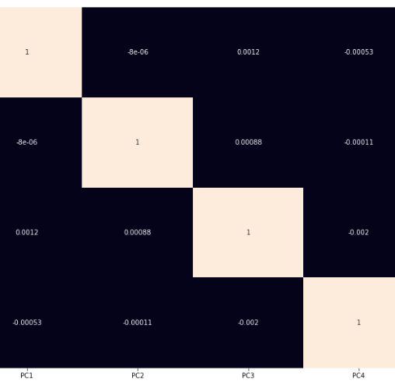
Principal Component Analysis
After doing dimensionality reduction via incremental PCA by taking 5 components, we see that the correlation in the data has almost reduced to zero.

Slide 9
SILHOUETTE ANALYSIS

Slide 10
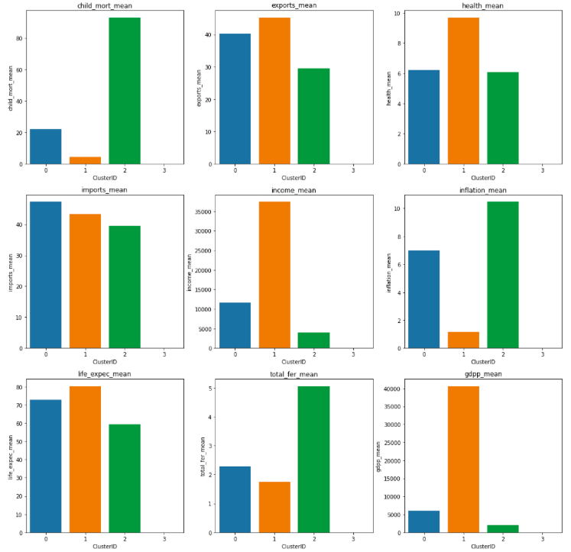
Clustering

Slide 11
Hierarchical Clustering

Slide 12
Hierarchical Clustering

Slide 13
Scatterplots between original variables and cluster id

Slide 14
Conclusion
The countries that require help the most are listed below:
1 Albania
2 Algeria
4 Antigua and Barbuda
5 Argentina
6 Armenia
Have Very low rate of net income per person, GDP per capita, average number of years a new born child would live, total health spending and imports of goods and services.
very high rate of measurement of the annual growth rate, number of children that would be born and child mortality rate.
It is clear that these countries require very quick aid in terms of money, education and services.

